Slide 1
ICE CREAM MANAGER

Slide 2
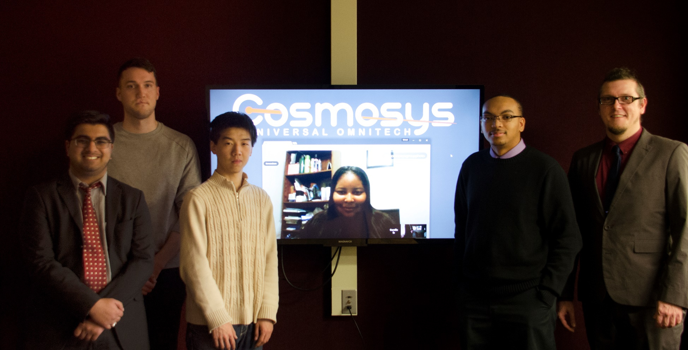
Development Team
(Left to Right) Aly Lakhani, Jacob Vacheresse, Fan Zhang, Camille Williams, Rodney Lewis, and Marc King

Slide 3
Updated Estimates
Estimate | Initial | Part 2 | Part 3
Wild Guess | 650 hours | 350 hours | ―
Lines of Code | 410 hours | 410 hours | ―
Function Point | 378 hours | 378 hours | ―
Task Driven | 355 hours | 355 hours | ―
 | Part 1 | Part 2 | Part 3 | Total
Initial Estimate | 50 | 300 | 139 | 489
Part 2 Estimate | 60 | 100 | 209 | 369
Actual Time | 60 | 93 | ― | ―
Difference | +10 | -7 | ― | ―

Slide 4
Complete ERD

Slide 5
Build ERD

Slide 6
Context DFD

Slide 7
0 DFD

Slide 8
Use Cases
UC01 – Modify Inventory
UC02 – Manage Sales
UC03 – Modify Route
UC04 – Modify Truck
UC05 – Process Batch File
UC06 – Modify Item
UC07 – Modify Driver
UC08 – Modify Settings
UC09 – Modify Voting
UC10 – Modify Preset
UC11 – View Fuel Usage

Slide 9
Manage Sales Use Case

Slide 10
Modify Inventory Use Case

Slide 11
Modify Item Use Case

Slide 12
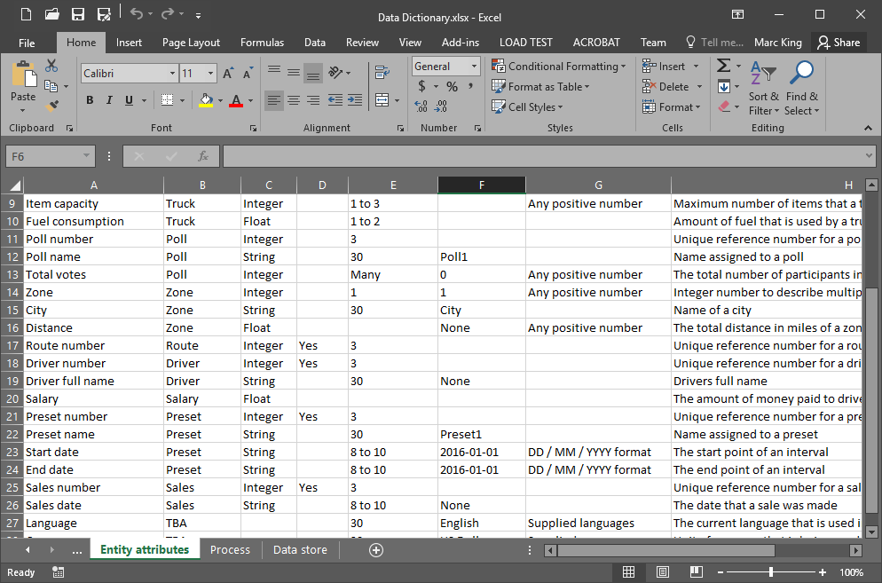
Data Dictionary

Slide 13
Traceability Matrix
Document |  | SPMP | SRSD | UCSD | DIAG | UC01 | UC02 | UC03 | UC04 | UC05 | UC06 | UC07 | UC08 | UC09 | UC10 | UC11 | DFDS | DATD
Software Project Management Plan | SPMP
Software Requirements Specification Document | SRSD
Use Case Summary Document | UCSD
Diagrams Visio Document | DIAG
Use Case - Modify Inventory | UC01
Use Case - Manage Sales | UC02
Use Case - Modify Route | UC03
Use Case - Modify Truck | UC04
Use Case - Process Batch File | UC05
Use Case - Modify Item | UC06
Use Case - Modify Driver | UC07
Use Case - Modify Settings | UC08
Use Case - Modify Voting | UC09
Use Case - Modify Presets | UC10
Use Case - View Fuel Usage | UC11
Data Flow Diagrams Document | DFDS
Data Dictionary | DATD

Slide 14
Traceability Matrix
Document | Section | Document | Section |  | Document | Section | Document | Section |  | Document | Section | Document | Section
DATD | REF | SRSD | 3.1.4 |  | SRSD | 4.1 | UC09 | REF |  | UC10 | 6.0 | DIAG | UC10
DIAG | CM | SRSD | 3.1.3 |  |  |  | UC10 | REF |  |  | REF | SRSD | 4.1
 | STDS | SRSD | 5.2 |  |  |  | UC11 | REF |  |  |  | UCSD | 3.0
 | UC01 | UC01 | 6.0 |  |  |  | UCSD | REF |  | UC11 | 2.1 | UCSD | 5.0
 |  | UCSD | 4.0 |  |  | 5.2 | DIAG | STDS |  |  | 6.0 | DIAG | UC11
 | UC02 | UC02 | 6.0 |  | UC01 | 2.1 | UCSD | 5.0 |  |  | REF | SRSD | 4.1
 |  | UCSD | 4.0 |  |  | 6.0 | DIAG | UC01 |  |  |  | UCSD | 3.0
 | UC03 | UC03 | 6.0 |  |  | REF | SRSD | 4.1 |  | UCSD | 3.0 | SRSD | 2.2
 |  | UCSD | 4.0 |  |  |  | UCSD | 3.0 |  |  |  | UC01 | REF
 | UC04 | UC04 | 6.0 |  | UC02 | 2.1 | UCSD | 5.0 |  |  |  | UC02 | REF
 |  | UCSD | 4.0 |  |  | 6.0 | DIAG | UC02 |  |  |  | UC03 | REF
 | UC05 | UC05 | 6.0 |  |  | REF | SRSD | 4.1 |  |  |  | UC04 | REF
 |  | UCSD | 4.0 |  |  |  | UCSD | 3.0 |  |  |  | UC05 | REF
 | UC06 | UC06 | 6.0 |  | UC03 | 2.1 | UCSD | 5.0 |  |  |  | UC06 | REF
 |  | UCSD | 4.0 |  |  | 6.0 | DIAG | UC03 |  |  |  | UC07 | REF
 | UC07 | UC07 | 6.0 |  |  | REF | SRSD | 4.1 |  |  |  | UC08 | REF
 |  | UCSD | 4.0 |  |  |  | UCSD | 3.0 |  |  |  | UC09 | REF
 | UC08 | UC08 | 6.0 |  | UC04 | 2.1 | UCSD | 5.0 |  |  |  | UC10 | REF
 |  | UCSD | 4.0 |  |  | 6.0 | DIAG | UC04 |  |  |  | UC11 | REF
 | UC09 | UC09 | 6.0 |  |  | REF | SRSD | 4.1 |  |  | 4.0 | DIAG | UC01
 |  | UCSD | 4.0 |  |  |  | UCSD | 3.0 |  |  |  | DIAG | UC02
 | UC10 | UC10 | 6.0 |  | UC05 | 2.1 | UCSD | 5.0 |  |  |  | DIAG | UC03
 |  | UCSD | 4.0 |  |  | 6.0 | DIAG | UC05 |  |  |  | DIAG | UC04
 | UC11 | UC11 | 6.0 |  |  | REF | SRSD | 4.1 |  |  |  | DIAG | UC05
 |  | UCSD | 4.0 |  |  |  | UCSD | 3.0 |  |  |  | DIAG | UC06
SPMP | 1.1 | SRSD | 1.2 |  | UC06 | 2.1 | UCSD | 5.0 |  |  |  | DIAG | UC07
 | 1.4 | SRSD | 1.4 |  |  | 6.0 | DIAG | UC06 |  |  |  | DIAG | UC08
 | 1.0 | SRSD | 1.0 |  |  | REF | SRSD | 4.1 |  |  |  | DIAG | UC09
SRSD | 2.2 | UCSD | 3.0 |  |  |  | UCSD | 3.0 |  |  |  | DIAG | UC10
 | 1.0 | SPMP | 1.0 |  | UC07 | 2.1 | UCSD | 5.0 |  |  |  | DIAG | UC11
 | 1.2 | SPMP | 1.1 |  |  | 6.0 | DIAG | UC07 |  |  | 5.0 | UC01 | 2.1
 | 1.4 | SPMP | 1.4 |  |  | REF | SRSD | 4.1 |  |  |  | UC02 | 2.1
 | 3.1.3 | DIAG | CM |  |  |  | UCSD | 3.0 |  |  |  | UC03 | 2.1
 | 3.1.4 | DATD | REF |  | UC08 | 2.1 | UCSD | 5.0 |  |  |  | UC04 | 2.1
 | 4.1 | UC01 | REF |  |  | 6.0 | DIAG | UC08 |  |  |  | UC05 | 2.1
 |  | UC02 | REF |  |  | REF | SRSD | 4.1 |  |  |  | UC06 | 2.1
 |  | UC03 | REF |  |  |  | UCSD | 3.0 |  |  |  | UC07 | 2.1
 |  | UC04 | REF |  | UC09 | 2.1 | UCSD | 5.0 |  |  |  | UC08 | 2.1
 |  | UC05 | REF |  |  | 6.0 | DIAG | UC09 |  |  |  | UC09 | 2.1
 |  | UC06 | REF |  |  | REF | SRSD | 4.1 |  |  |  | UC10 | 2.1
 |  | UC07 | REF |  |  |  | UCSD | 3.0 |  |  |  | UC11 | 2.1
 |  | UC08 | REF |  | UC10 | 2.1 | UCSD | 5.0 |  |  | REF | SRSD | 4.1

Slide 15
Metrics
Team-Created
Requirements Metrics
Specificity
Completeness
Object-Oriented Metrics
Responsibility
Linking
Source Code Quality Metrics
Operations
Parameters
Manager-Created
Function-Based Metrics
Architectural Design Metrics
Structural Complexity
Data Complexity
System Complexity
Requirements Volatility Metrics

Slide 16
Validation
Unit Testing
Integration Testing
Top-Down Approach
Regression
White-Box
Validation Testing
Configuration Review
Customer Acceptance Testing
Black-Box Testing
Performance Testing
Refactoring
Deployment Testing

Slide 17
Part 2 Evaluation
What are we changing for Part 3?
Nothing. Let the coding commence.
What went well?
Task performance.
What didn't go so well?
Task completion during break.
What was the hardest thing?
Data Dictionary and the Traceability Matrix
What was the easiest thing?
Things we could copy/paste between documents.
What would we change if we restarted?
Actually do the UCSD first and together, and ask the
customer more requirements questions earlier.

Slide 18
ICE CREAM MANAGER Q & A
Notes:
Good evening and welcome to the 2016 Cosmosys Universal Omnitech developer conference.

